Slide 1
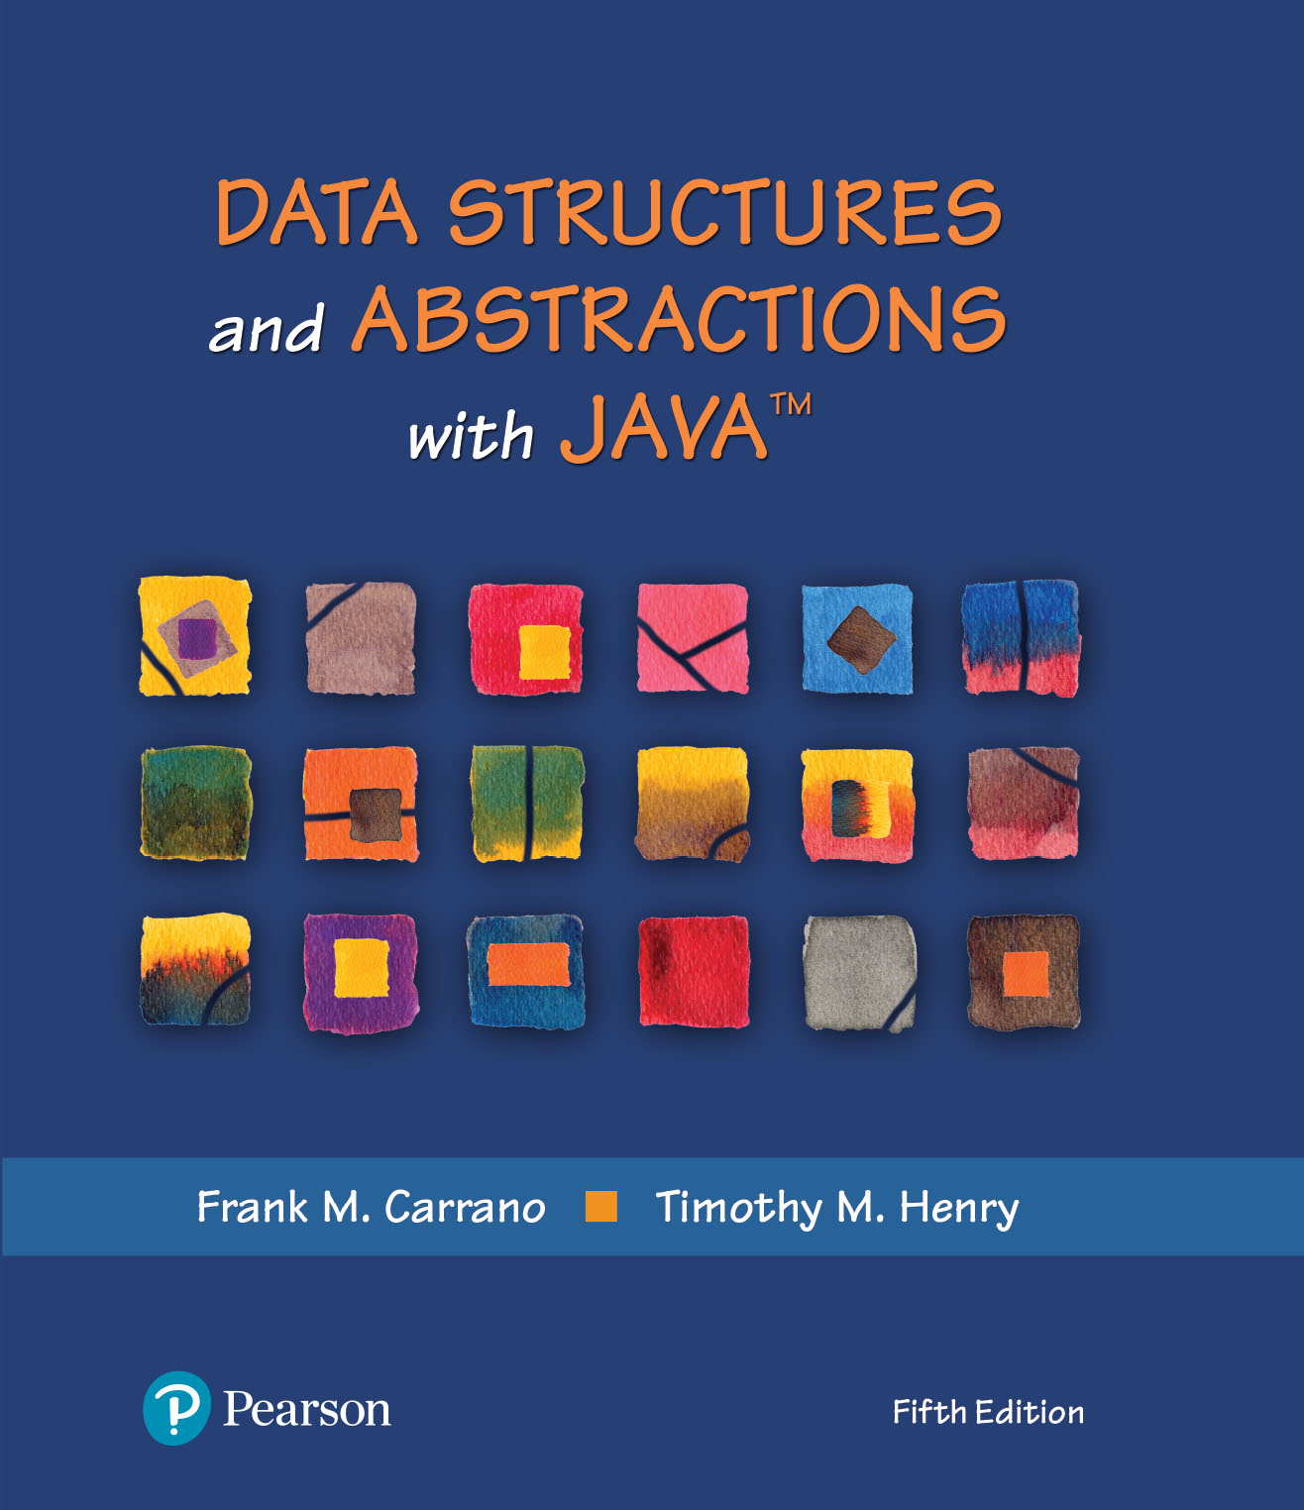
Data Structures and Abstractions with Java™
5th Edition
Module 2
Exceptions

Slide 2
Exceptions
An exception is an object that describes an unusual or erroneous situation
Exceptions are thrown by a program, and may be caught and handled by another part of the program
A program can be separated into a normal execution flow and an exception execution flow

Slide 3
Exception Handling
Java has a predefined set of exceptions and errors that can occur during execution
A program can deal with an exception in one of three ways:
ignore it
handle it where it occurs
handle it an another place in the program
The manner in which an exception is processed is an important design consideration

Slide 4
Exception Handling
If an exception is ignored by the program, the program will terminate abnormally and produce an appropriate message
The message includes a call stack trace that:
indicates the line on which the exception occurred
shows the method call trail that lead to the attempted execution of the offending line

Slide 5
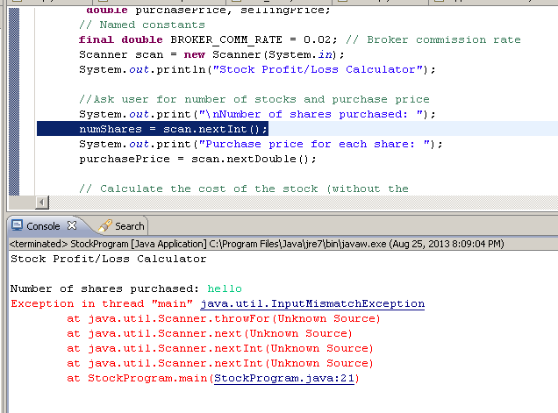

Slide 6
The Basics
Method creates an exception object
We say “throws an exception”
Signal to program
Unexpected has happened
Handle the exception
Detect and react

Slide 7
Checked and Unchecked Exceptions
Two types of exceptions:
Checked
The compiler checks that you don’t ignore them
Due to external circumstances that the programmer cannot prevent
Majority occur when dealing with input and output
For example, IOException
Unchecked
Extend the class RuntimeException or Error
They are the usually programmer’s or user’s fault
Examples of runtime exceptions:
NumberFormatException
IllegalArgumentException
NullPointerException
Example of error:
OutOfMemoryError

Slide 8
Checked Exceptions
A checked exception either must be caught by a method, or must be listed in the throws clause of any method that may throw or propagate it
A throws clause is appended to the method header
The compiler will issue an error if a checked exception is not caught or asserted in a throws clause
Used primarily when programming with files and streams
Scanner in = new Scanner(System.in);

Slide 9
Throws clause
Two choices:
Handle the exception
Tell compiler that you want the method to be terminated when the exception occurs
Use throws specifier so method can throw a checked exception
For multiple exceptions:
public void read(String filename) throws FileNotFoundException
{
FileReader reader = new FileReader(filename);
Scanner in = new Scanner(reader);
...
}
public void read(String filename)throws IOException, ClassNotFoundException

Slide 10
Suppose a method calls the Scanner constructor, which can throw a FileNotFoundException, and the nextInt method of the Scanner class, which can cause a NoSuchElementException or InputMismatchException.
Which exceptions should be included in the throws clause?

Slide 11
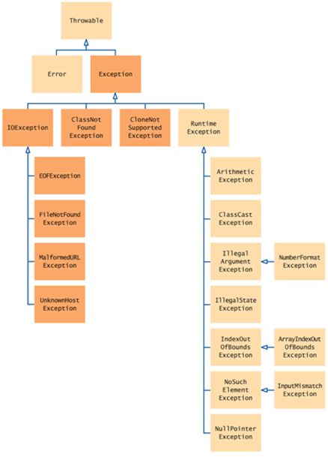
FileNotFoundException, NoSuchElementException InputMismatchException.
You must include the FileNotFoundException and you may include the NoSuchElementException if you consider it important for documentation purposes. InputMismatchException is a subclass of NoSuchElementException.
It is your choice whether to include it.

Slide 12
The Basics
Checked exceptions in the Java Class Library
ClassNotFoundException
FileNotFoundException
IOException
NoSuchMethodException
WriteAbortedException

Slide 13
The Basics
Runtime exceptions in the Java Class Library
ArithmeticException
ArrayIndexOutOfBoundsException
ClassCastException
IllegalArgumentException
IllegalStateException
IndexOutOfBoundsException
NoSuchElementException
NullPointerException
StringIndexOutOfBoundsException
UnsupportedOperationException

Slide 14
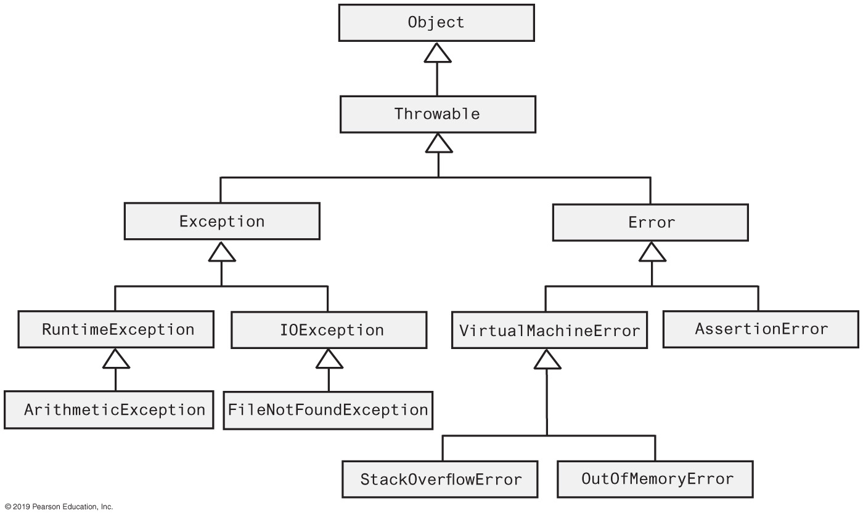
Java Class Exception and Error Hierarchy
FIGURE J2-1 The hierarchy of some standard exception and error classes

Slide 15
The try Statement
To handle an exception in a program, the line that throws the exception is executed within a try block
A try block is followed by one or more catch clauses
Each catch clause has an associated exception type and is called an exception handler
When an exception occurs, processing continues at the first catch clause that matches the exception type

Slide 16
Handling an Exception
Postpone handling: The throws clause
If programmer not sure what action is best for a client when an exception occurs
Leave the handling of the exception to the method’s client
Method that can cause but does not handle checked exception must declare in its header
public String readString(. . .) throws IOException

Slide 17
Handle It Now: The try-catch Blocks
try
{
< Possibly some code >
anObject.readString(. . .); // Might throw an IOException
< Possibly some more code >
}
catch (IOException e)
{
< Code to react to the exception, probably including the following statement: >
System.out.println(e.getMessage());
}
Code to handle an IOException as a result of invoking the method readString

Slide 18
Multiple catch Blocks
catch (FileNotFoundException e)
{
. . .
}
catch (IOException e) // Handle all other IOExceptions
{
. . .
}
Good order for catch blocks

Slide 19
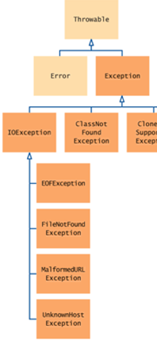
Catching Exceptions
Example:
try
{
String filename = ...;
FileReader reader = new FileReader(filename);
Scanner in = new Scanner(reader);
String input = in.next();
int value = Integer.parseInt(input);
...
}
catch (IOException exception)
{
exception.printStackTrace();
}
catch (NumberFormatException exception)
{
System.out.println("Input was not a number");
}

Slide 20
Catching Exceptions
The code can exit the try/catch block in several ways:
The code inside the try block successfully ends and the program continues with next executable line after the catch clauses.
The code inside the try block runs into a return statement and returns to the calling method.
The code inside the try block throws an exception and control goes to the matching catch block.
The code inside the try block throw an exception, but there are no matching catch blocks, returns to the calling method and looks for a matching control block. If none of the enclosing method calls catch the exception, the program terminates.

Slide 21
Catching Exceptions
try
{
String filename = ...;
FileReader reader = new FileReader(filename);
Scanner in = new Scanner(reader);
String input = in.next();
int value = Integer.parseInt(input);
. . .
if (. . .) return;
. . .
}
catch (IOException exception)
{
exception.printStackTrace();
}
catch (NumberFormatException exception)
{
System.out.println("Input was not a number");
}
2
1

Slide 22
Catching Exceptions
try
{
String filename = ...;
FileReader reader = new FileReader(filename);
Scanner in = new Scanner(reader);
String input = in.next();
int value = Integer.parseInt(input);
. . .
if (. . .) return;
. . .
}
catch (IOException exception)
{
exception.printStackTrace();
}
catch (NumberFormatException exception)
{
System.out.println("Input was not a number");
}
Exception raised
3

Slide 23
public void getInput()
{
try
{
Scanner in = new Scanner(System.in);
System.out.print(“Enter filename “);
String filename = in.next();
read(filename);
}
catch (NumberFormatException exception)
{
System.out.println("Input was not a number");
}
}
4
public void read(String filename){
try
{
String filename = ...;
FileReader reader = new FileReader(filename);
Scanner in = new Scanner(reader);
String input = in.next();
int value = Integer.parseInt(input);
. . .
if (. . .) return;
. . .
}
catch (IOException exception)
{
exception.printStackTrace();
}
}
Exception raised
No matching block

Slide 24
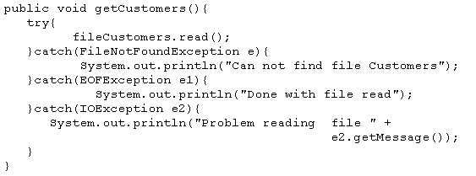
Catching Exceptions
The order of the catch statements may be important if the exceptions being caught belong to the same inheritance branch.
For example, the class EOFException is a subclass of the more generic IOException, and you have to put the catch block for the subclass first.

Slide 25
The finally Clause
Exception terminates current method
Danger: Can skip over essential code
Example:
reader = new FileReader(filename);
Scanner in = new Scanner(reader);
readData(in);
reader.close(); // May never get here
Must execute reader.close() even if exception happens
Use finally clause for code that must be executed “no matter what”

Slide 26
The finally Clause
FileReader reader = new FileReader(filename); try { Scanner in = new Scanner(reader); readData(in); } finally { reader.close();
// if an exception occurs, finally clause // is also executed before exception
// is passed to its handler }

Slide 27
The finally Clause
Executed when try block is exited in any of three ways:
After last statement of try block
After last statement of catch clause, if this try block caught an exception
When an exception was thrown in try block and not caught

Slide 28
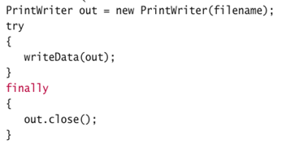
Something to consider!
Why was the out variable declared outside the try block?
Answer: If it had been declared inside the try block, its scope would only have extended to the end of the try block, and the finally clause could not have closed it.

Slide 29
Throwing an Exception
A method intentionally throws an exception by executing a throw statement.
Programmers usually create the object within the throw statement
throw new IOException();

Slide 30
Throwing an Exception
If you can resolve unusual situation in a reasonable manner
likely can use a decision statement
If several resolutions to abnormal occurrence possible, and you want client to choose
Throw a checked exception
If a programmer makes a coding mistake by using your method incorrectly
Throw a runtime exception

Slide 31
Designing Your Own Exception Types
You can design your own exception types — subclasses of Exception or RuntimeException
Extend RuntimeException or one of its subclasses
Supply two constructors
Default constructor
A constructor that accepts a message string describing reason for exception
public class InsufficientFundsException extends RuntimeException { public InsufficientFundsException() {} public InsufficientFundsException(String message) { super(message); } }

Slide 32
Designing Your Own Exception Types
Throw an exception object to signal an exceptional condition
Example: InsufficientFundsException
InsufficientFundsException exception
= new InsufficientFundsException("Amount exceeds balance"); throw exception;
Anonymous exception (has no name):
throw new InsufficientfundsException("Amount exceeds balance");
When an exception is thrown, method terminates immediately

Slide 33
Designing Your Own Exception Types
public class BankAccount { public void withdraw(double amount) {
try
{ if (amount > balance) { throw new InsufficientFundsException ("Amount exceeds balance");
} balance = balance – amount;
}
catch (InsufficientFundsException exception)
{
exception.printStackTrace();
} } ... }

Slide 34
Suppose you construct a new bank account object with a zero balance and
then call withdraw(10). What is the value of balance afterwards?
public class BankAccount { public void withdraw(double amount) {
try
{ if (amount > balance) { throw new InsufficientFundsException ("Amount exceeds balance");
} balance = balance – amount;
}
catch (InsufficientFundsException exception)
{
exception.printStackTrace();
} } ... }
The balance is still zero because the last statement of the withdraw method was never executed.

Slide 35
Example of exception handled in different place than discovered
GUI Driver
Data Manager
Data Element
Bank
Bank Account
Arraylist <BankAccount>
Extracts withdraw amount and account number from user
int withdraw(acct, amt)
{
}
Displays new balance to user
int withdraw(amt)
{
}
Normal execution flow

Slide 36
Example of exception handled in different place than discovered
GUI Driver
Data Manager
Data Element
Bank
Bank Account
Arraylist <BankAccount>
try {
Extracts withdraw amount and account number from user
int withdraw(acct, amt) throws IFE
{
}
Displays new balance to user
}
catch (IFE)
int withdraw(amt) throws IFE
{
if amt > balance
throw IFE;
}
no catch for IFE
no catch for IFE
This is where is exception is discovered
This is where is exception can be resolved
Exception execution flow

Slide 37
Programmer-Defined Exception Classes
/** A class of runtime exceptions thrown when an attempt
is made to find the square root of a negative number. */
public class SquareRootException extends RuntimeException
{
public SquareRootException()
{
super("Attempted square root of a negative number.");
} // end default constructor
public SquareRootException(String message)
{
super(message);
} // end constructor
} // end SquareRootException
LISTING JI3 -1 The exception class SquareRootException

Slide 38
Programmer-Defined Exception Classes
public class OurMath
{
/** Computes the square root of a nonnegative real number.
@param value A real value whose square root is desired.
@return The square root of the given value.
@throws SquareRootException if value < 0. */
public static double squareRoot(double value) throws SquareRootException
{
if (value < 0)
throw new SquareRootException();
else
return Math.sqrt(value);
} // end squareRoot
// < Other methods not relevant to this discussion are here. >
} // end OurMath
LISTING JI3-2 The class OurMath and its static method squareRoot

Slide 39
Programmer-Defined Exception Classes
/** A demonstration of a runtime exception using the class OurMath. */
public class OurMathDriver
{
public static void main(String[] args)
{
System.out.print("The square root of 9 is ");
System.out.println(OurMath.squareRoot(9.0));
System.out.print("The square root of -9 is ");
System.out.println(OurMath.squareRoot(-9.0));
System.out.print("The square root of 16 is ");
System.out.println(OurMath.squareRoot(16.0));
} // end main
} // end OurMathDriver
Program Output
The square root of 9 is 3.0
The square root of -9 is Exception in thread "main" SquareRootException:
Attempted square root of a negative number.
at OurMath.squareRoot(OurMath.java:14)
at OurMathDriver.main(OurMathDriver.java:12)
LISTING JI3 -3 A driver for the class OurMath

Slide 40
Programmer-Defined Exception Classes
/** A class of static methods to perform various mathematical
computations, including the square root. */
public class JoeMath
{
/** Computes the square root of a real number.
@param value A real value whose square root is desired.
@return A string containing the square root. */
public static String squareRoot(double value)
{
String result = "";
try
{
Double temp = OurMath.squareRoot(value);
result = temp.toString();
}
catch (SquareRootException e)
{
Double temp = OurMath.squareRoot(-value);
result = temp.toString() + "i";
}
return result;
} // end squareRoot
// < Other methods not relevant to this discussion could be here. >
} // end JoeMath
LISTING JI3 -4 The class JoeMath

Slide 41
Programmer-Defined Exception Classes
/** A demonstration of a runtime exception using the class JoeMath. */
public class JoeMathDriver
{
public static void main(String[] args)
{
System.out.print("The square root of 9 is ");
System.out.println(JoeMath.squareRoot(9.0));
System.out.print("The square root of -9 is ");
System.out.println(JoeMath.squareRoot(-9.0));
System.out.print("The square root of 16 is ");
System.out.println(JoeMath.squareRoot(16.0));
System.out.print("The square root of -16 is ");
System.out.println(JoeMath.squareRoot(-16.0));
} // end main
} // end JoeMathDriver
Program Output
The square root of 9 is 3.0
The square root of −9 is 3.0i
The square root of 16 is 4.0
The square root of −16 is 4.0i
LISTING JI3 -5 A driver for the class JoeMath

Slide 42
Inheritance and Exceptions
public class SuperClass
{
public void someMethod() throws Exception1
{
} // end someMethod
} // end SuperClass
public class SubClass extends SuperClass
{
public void someMethod() throws Exception1, Exception2 // ERROR!
{
} // end someMethod
} // end SubClass
Consider this superclass and subclass — cannot override someMethod in a subclass and list additional checked exceptions in its throws clause

Slide 43
Inheritance and Exceptions
public class Driver
{
public static void main(String[] args)
{
SuperClass superObject = new SubClass();
try
{
superObject.someMethod();
}
catch (Exception1 e)
{
System.out.println(e.getMessage());
}
} // end main
} // end Driver
Only Exception1 is caught. If the throws clause in SubClass was legal, we could call SubClass’s someMethod without catching Exception2.

Slide 44
Inheritance and Exceptions
public class SuperClass
{
public void someMethod() throws Exception1
{
} // end someMethod
} // end SuperClass
public class SubClass extends SuperClass
{
public void someMethod() throws Exception2 // OK, assuming Exception2
{ // extends Exception1
} // end someMethod
} // end SubClass
If Exception2 extends Exception1, the above is legal

